Slide 1





STOCK MARKET FORECAST
Team : ANBUSELVAN M
Email : anbuselvan24703@gmail.com
Guide: (P.Raja, Master Trainer )
Disclaimer: The content is curated for educational purposes only.
Notes:
Slides: Prepare a short slide deck (10-12 slides) summarizing the project objectives, methodology, and key results.

Slide 2
OUTLINE
Abstract
Problem Statement
Proposed System/Solution
Algorithm & Deployment
GitHub Link
Project Demo(photos / videos)
Conclusion
Future Scope
References

Slide 3
Abstract
Customer and employee churn are major challenges for businesses, leading to revenue loss and high costs. This paper looks at machine learning techniques for predicting both customer and employee churn, comparing the two approaches. A real-life case study shows how these techniques work in practice. We also introduce an Employee Value Model (EVM), similar to Customer Lifetime Value (CLV), to help identify and retain valuable employees, aiding in better retention strategies.

Slide 4
Problem Statement
Customer churn has long been a notorious challenge for many industries, particularly those in competitive service markets such as telecommunications, banking, and insurance. Customer churn leads to direct revenue loss, brand deterioration, and operational inefficiencies. Employee churn, though similar, often results in more profound organizational disruptions, including loss of specialized knowledge, project delays, and recruitment costs. Predictive models for both customer and employee churn are crucial tools for organizations to proactively manage retention efforts and minimize negative impacts on business performance.

Slide 5
Proposed Solution
To address customer and employee churn, businesses should collect historical data on customer behavior and employee performance, identifying key factors that contribute to churn. Using machine learning algorithms, predictive models can be built to forecast churn for both groups. A real-world case study can help refine these models. Additionally, an Employee Value Model (EVM), similar to Customer Lifetime Value (CLV), can be developed to assess the long-term value of employees. Insights from these models should guide targeted retention strategies, such as personalized offers for customers or career development programs for employees, while continuously monitoring and updating the models to ensure their effectiveness.

Slide 6
Github project link
https://github.com/anbuselvan24703/NAAN-MUDHALVAN-PROJECT.git
Notes:
thank you very much for joining this PPT, keep learning.
6

Slide 7
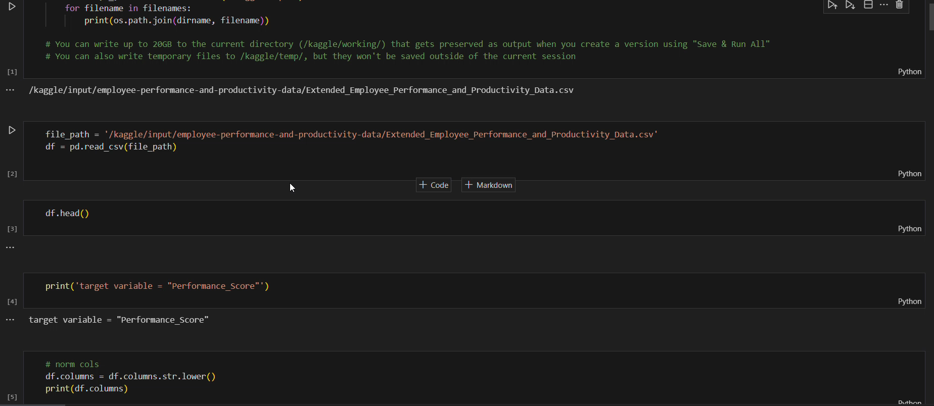
Video of Project Demo

Slide 8
Conclusion
This study demonstrates the utility of predictive models in addressing churn issues for both customers and employees. By leveraging machine learning techniques and value-based models, businesses can better understand churn patterns, optimize retention efforts, and mitigate the negative impacts of turnover.

Slide 9
Future Scope
Real-time
AI-driven
cross-industry
personalized
predictive.

Slide 10
Thank you!
Notes:
thank you very much for joining this PPT, keep learning.
10

